Slide 1
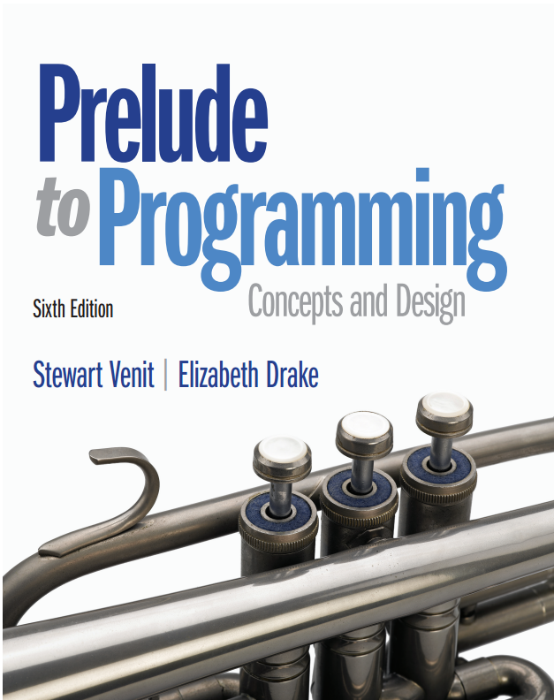
Prelude to Programming
Sixth Edition
Chapter 8
Searching and Sorting Arrays
Copyright © 2015, 2011, 2009 Pearson Education, Inc. All Rights Reserved
Notes:
If this PowerPoint presentation contains mathematical equations, you may need to check that your computer has the following installed:
1) MathType Plugin
2) Math Player (free versions available)
3) NVDA Reader (free versions available)

Slide 2
Searching and Sorting
We often need to search an array for a specific item.
We often need to sort an array (from highest to lowest, into alphabetical order, and so on).
There are many algorithms for searching and sorting.
You could probably think of ways to write your own original programs to search or sort but you should also know how to evaluate algorithms that are available for a task and be able to select which best serves your purpose in a given situation.

Slide 3
8.1 The Serial Search Technique
Steps:
Load, or populate, the arrays.
Identify the key (the item to locate).
Search the array that contains the key to find a match.
Display the key and corresponding values in the non-key arrays with the same subscript as the one with the key value, if a match is found.
Display an “unsuccessful search” message if no matches are found.

Slide 4
Use a Flag
Use a flag, or switch, to decide which message to print.
A flag is a Boolean variable that is set to 0 or 1 (true or false), depending on the results of an operation.
The value of the flag can be checked later in the program with an If statement to determine which action to take.

Slide 5
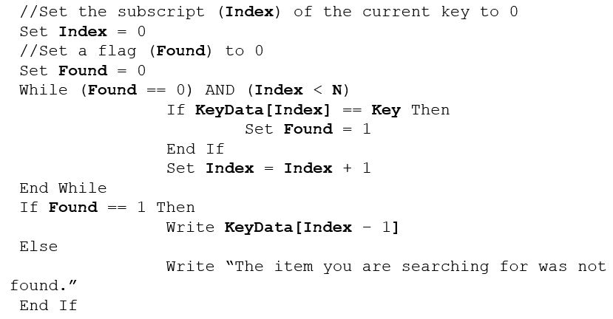
General Pseudocode for the Serial Search

Slide 6
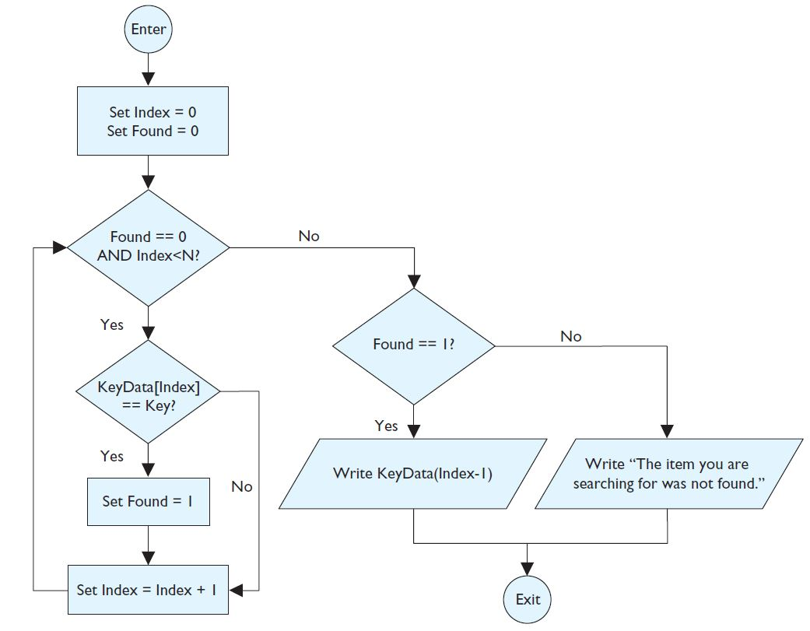
Flowchart for the Serial Search

Slide 7
Example: Searching and Parallel Arrays
This program segment displays the test score for a particular student when the student’s identification number is input by the user.
It searches an array, I D Numbers, which consists of identification numbers for the I D number input (I D Key).
Then it does the following:
Displays the corresponding student name and test score contained in two parallel arrays named Names and Scores, if the number I D Key is found in the I D Numbers array or…
Displays an appropriate message if the I D Key is not found in the I D Numbers array

Slide 8
Example: Searching and Parallel Arrays (1 of 2)
Pseudocode is on next slide.
Assume that the arrays I D Numbers, Names, and Scores have already been declared and loaded with the necessary data.
Assume that the number of elements in each of these parallel arrays is N, the variables I D Key, and Index, have been declared as Integer variables, and Found has been declared as a Boolean variable.

Slide 9
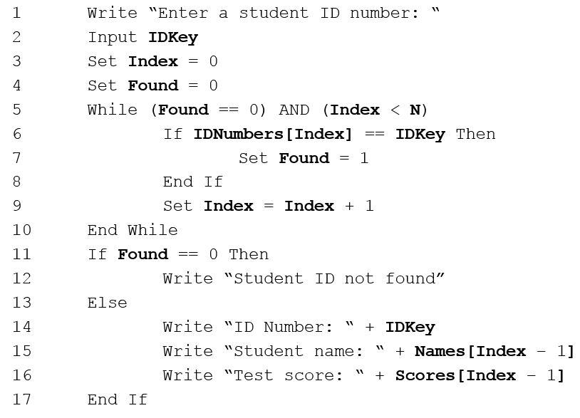
Example: Searching and Parallel Arrays (2 of 2)

Slide 10
8.2 The Bubble Sort Technique
To sort data means to arrange it in a particular numerical or alphabetical order, ascending or descending.
To sort small amounts of data, use the bubble sort technique.
Make several passes through the data.
Compare adjacent pairs of data.
If the pairs are not in order, swap them.
Continue until all data is processed.

Slide 11
Swapping Values
To swap two values, you must store one of them in a temporary storage location while you make the swap.
To interchange array elements Array[K] and Array[K + 1], the pseudocode for the swap looks like this:
Walk through the swap routine with a few values to see how it works
What will be the value in Temp?

Slide 12
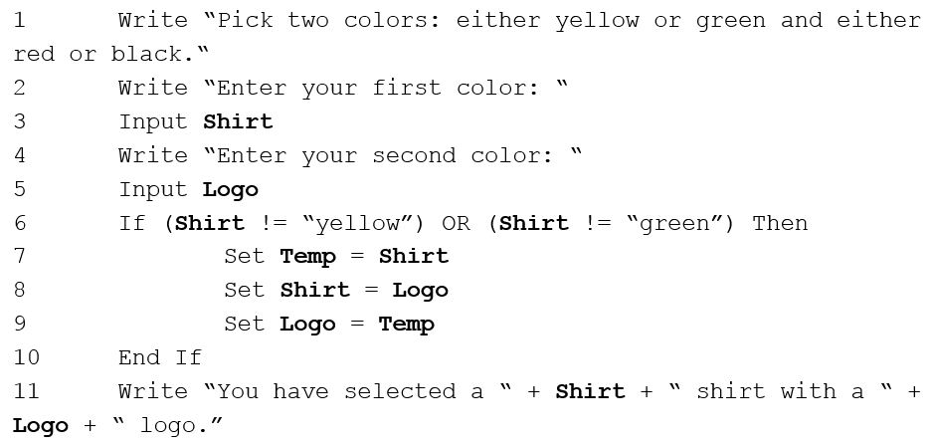
Swap Example
The shirt can be either yellow or green and the logo can be either black or red. (assumption: only the 4 colors specified are entered but may be in incorrect order)

Slide 13
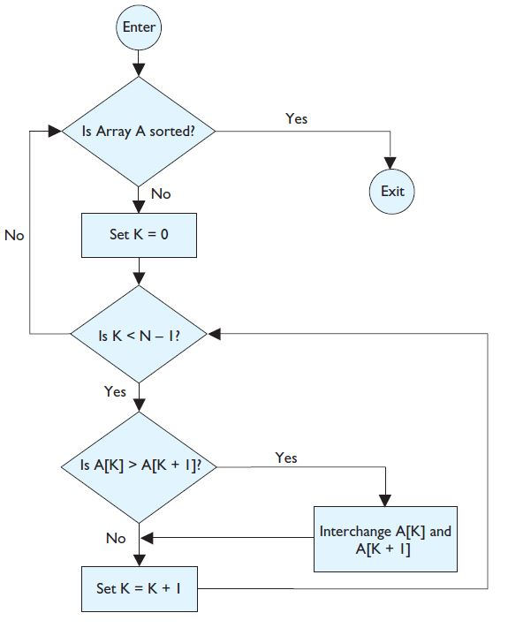
Flowchart for the Bubble Sort

Slide 14
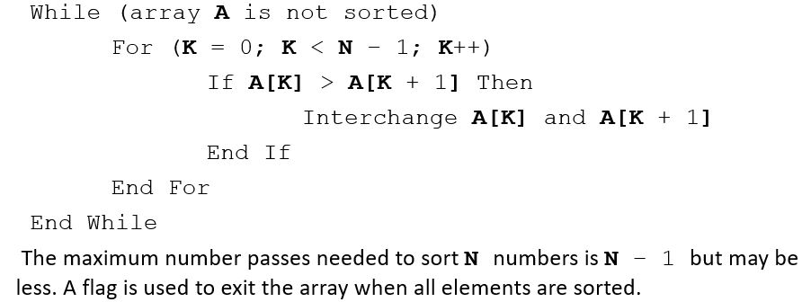
General Pseudocode for the Bubble Sort
Given an array, A, with N elements:

Slide 15
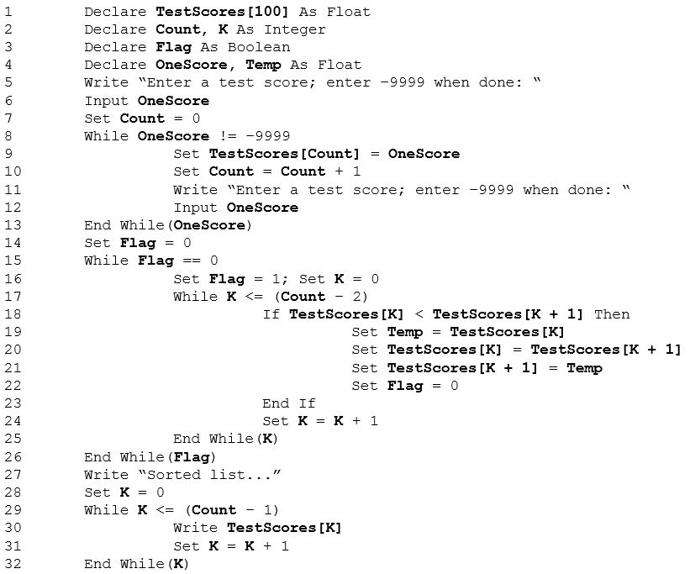
Example: Input Numbers in Any Order and Sort Them

Slide 16
8.3 The Binary Search
The binary search method is a good way to search a large amount of data for a particular item.
That item is called the search key.
The binary search works better for large amounts of data than the serial search.
The binary search is:
more efficient than the serial search technique
requires that the table keys, the array of data to be searched, is in numerical or alphabetical order

Slide 17
General Process for the Binary Search
First compare the search key (the target) to the table key midway through the given array.
Because the array data is ordered, it is possible to see in which half of the array the search key lies.
Then compare the search key to the table key in the middle of this half.
This determines in which quarter of the array the search key is located.
Then look at the middle entry in this quarter.
Continue this process until search key is found.

Slide 18
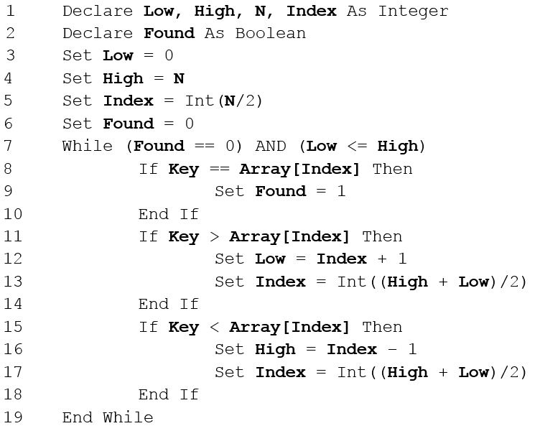
General Pseudocode for Binary Search

Slide 19
Combining Parallel Arrays and a Binary Search (1 of 2)
Professor Crabtree saves all her student records in parallel arrays.
The array Names holds the students’ names, listed alphabetically by last name.
Each time she gives an exam or grades a homework assignment, she adds a new parallel array: Exam1, Exam2, H W 1, H W 2, and so on.
Now Dr. Crabtree wants to be able to locate the record for one specific student.

Slide 20
Combining Parallel Arrays and a Binary Search (2 of 2)
The pseudocode on the next slide assumes the following parallel arrays have been declared, filled with data, and that the following variables have been declared:
Names[100] is an array of Strings with each element holding a student’s last name
First[100] is an array of Strings with each element holding a student’s first name
Exam1[100], H W 1[100], and H W 2[100] are parallel arrays of Floats.
Low, High, N, and Index are Integer variables.
Found is a Boolean variable.
Student is a String variable.

Slide 21
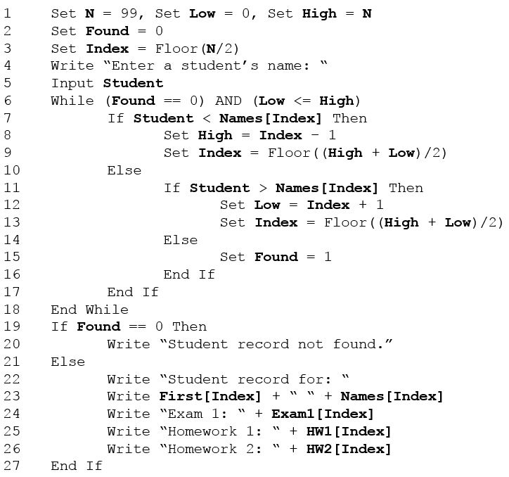
Professor Crabtree’s Pseudocode

Slide 22
8.4 The Selection Sort
The selection sort procedure is a more efficient way to sort data stored in an array than the bubble sort.
Basic idea:
On 1st pass, locate the smallest array element and swap it with the first array element.
On 2nd pass, locate the second smallest element and swap it with the second element of the array.
On the 3rd pass, locate the next smallest element and swap it with the third element of the array and so forth...
If the array contains N elements, it will be completely sorted after, at most,
N – 1 passes.

Slide 23
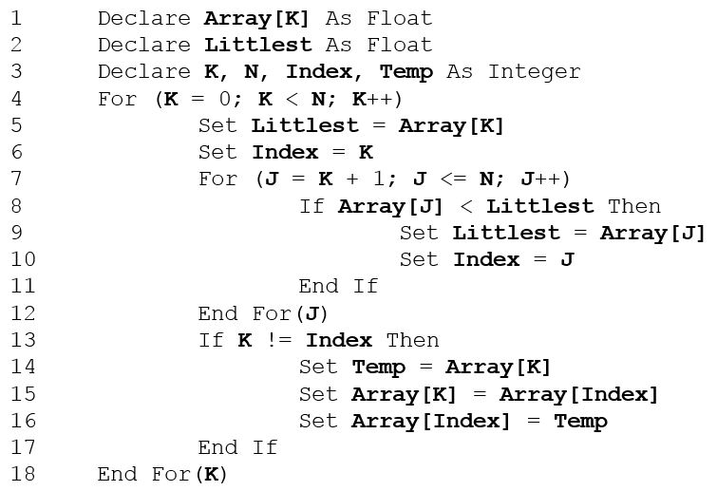
General Pseudocode for the Selection Sort

Slide 24
Applying the Selection Sort Technique
In this example assume we have an array that holds the ages of 200 students in Professor Crabtree’s classes. This program will sort the array in ascending order.
The pseudocode is on the following slide.
To save space we will assume:
Ages[200] is an array of Integers with each element holding the age of a student (in years).
Youngest, J, K, M, N, Temp and, Index are Integer variables.

Slide 25
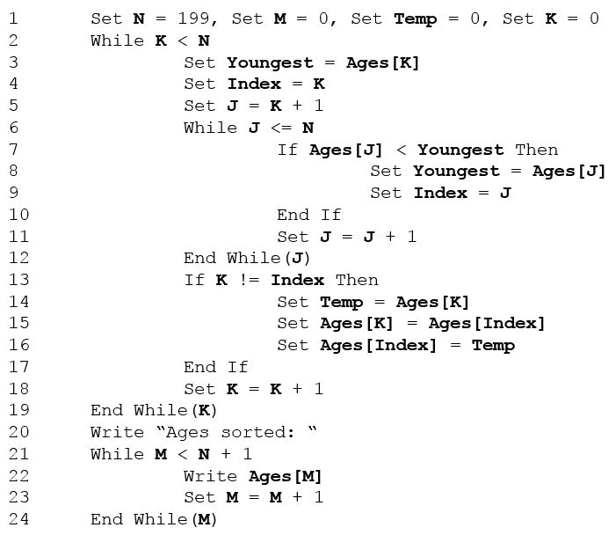
Example: Use the Selection Sort to Sort a Large Data Set

Slide 26

Copyright

